Slide 1

Combating Against Cyber Financial Fraud
Machine Learning and Deep Learning solution for solving Spam Calls, Deep Fake audio.

Slide 2

Problem Statement: Cyber financial fraud, including spam calls and deepfake audio, is rapidly increasing.
Fraudsters are using AI to bypass traditional security measures.
These activities result in billions of dollars in losses and damage trust in financial systems.
Industry Context: In 2023:
Over 60% of financial fraud involved spam calls.
Deepfake-related incidents surged by 300%.
The need for detection:
Real-time.
Accurate.
Why It Matters: "Without robust solutions, financial institutions risk losing customer trust, facing regulatory penalties, and incurring massive financial losses. Our ML-powered solution addresses these challenges head-on."

Slide 3

Challenges in Detecting Spam Calls
Spurious Data
Real-time Detection
Large amounts of data can be misleading.
Real-time detection is paramount.
Spam calls often imitate legitimate calls.
Delays in identification enable scammers to exploit vulnerabilities.
Identifying true fraudulent attempts becomes challenging.
This can lead to substantial financial damage.
Evolving Scamming Tactics
Scammers are constantly evolving their tactics, requiring constant adaptation and updates to detection mechanisms to remain effective.

Slide 4

Leveraging NLP to Combat Spam Calls
1
Text Analysis
NLP allows the analysis of the content of spam calls, extracting key information, identifying suspicious phrases, and detecting common scam tactics.
2
Sentiment Analysis
Sentiment analysis can identify the emotional tone of a spam call, often revealing aggressive or persuasive language used by scammers.
3
Pattern Recognition
NLP algorithms can identify patterns in language, identifying repeated phrases or keywords used in spam calls to create a profile of fraudulent activity.

Slide 5
Natural Language Processing (NLP)
What is NLP?
Natural Language Processing (NLP): A branch of AI.
Focuses on computer-human language interaction.
Enables machines to understand, interpret, and generate human language.
How NLP Works
Text Preprocessing
Tokenization: Splitting text into words/phrases.
Stopword Removal: Removing common words (e.g., "the", "is").
Lemmatization/Stemming: Reducing words to their root form.
Cleaning: Removing special characters, digits, and noise.
Feature Extraction
Bag of Words (BOW): Word frequency representation.
TF-IDF: Weighing words by importance.
Word Embeddings: Vectorized word representations (e.g., Word2Vec, GloVe).
Model Training
Train NLP models (e.g., Naive Bayes, LSTM, BERT) for tasks like classification or translation.
Evaluation
Use metrics like accuracy, precision, recall, and F1-score.

Slide 6
TF-IDF Vectorization:
Converts text into numerical features using TfidfVectorizer.
Assigns weights to words based on importance in a document vs. the dataset.
max_features=2000: Limits features to the top 2000 words to reduce dimensionality.
Model training using Naive Bayes Classifier
Trained using MultinomialNB on TF-IDF data.
A probabilistic model ideal for text data.
Effective for binary tasks like fraud detection.
Naive Bayes-
Probabilistic classification model.
Works well with text.
Assumes feature independence
Fast and efficient.
Ideal for binary tasks.

Slide 7
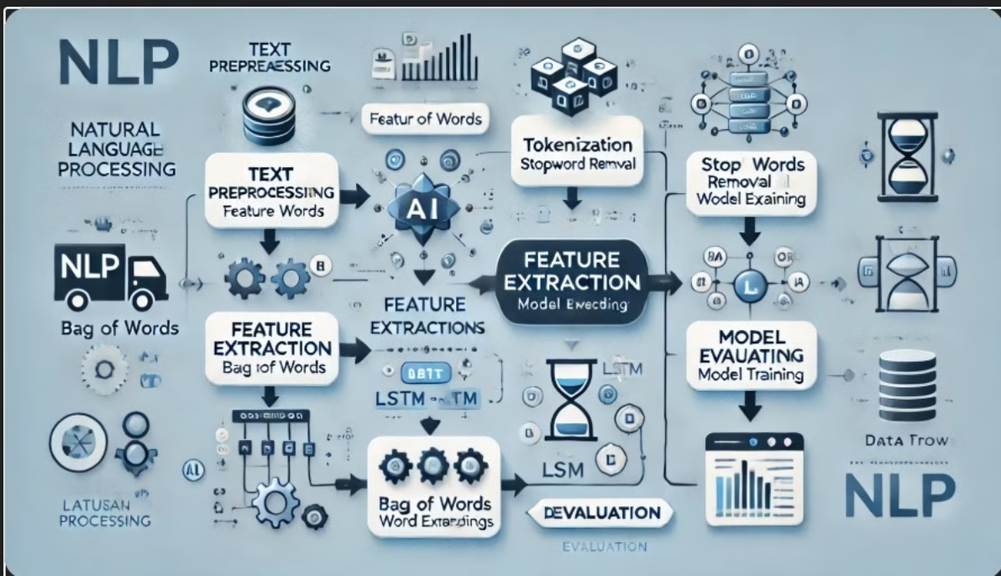
Flowchart for NLP

Slide 8
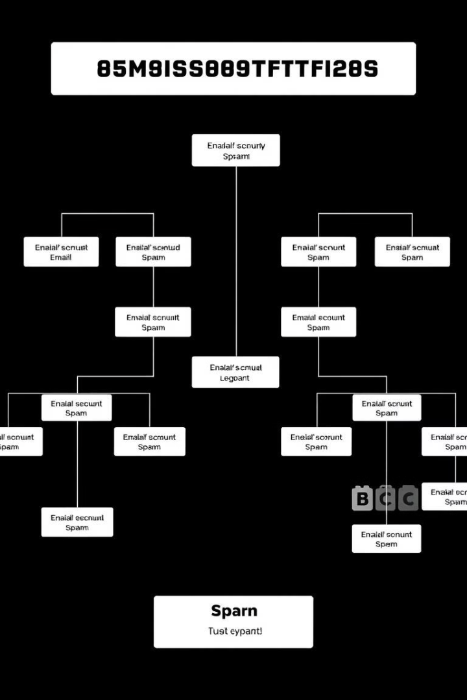



Random Forest Algorithm for Spam Call Identification
Decision Trees
Random Forest uses multiple decision trees, each trained on a subset of the data, to create a robust model for spam call identification.
Ensemble Learning
The ensemble of decision trees is used to make a final prediction, improving accuracy and reducing the risk of overfitting.
Feature Importance
Random Forest can identify the most important features for predicting spam calls, providing insights into the characteristics of fraudulent activity.

Slide 9
Random forest for classifying Spam Calls
Data Preparation:
Dataset: call_details.csv containing features like call duration, time of day, frequency, etc.
Target Variable: Binary classification (isFraud column indicating spam or not).
Preprocessing: Handled missing values, scaled features, and split data into training and testing sets.
Model Training:
Parameters: n_estimators=100 (100 trees)
Model Evaluation:
Accuracy: Achieved 97.09% on the test set.
Classification Report:
Precision: 0.98 (non-spam), 0.87 (spam).
Recall: 0.99 (non-spam), 0.84 (spam).
F1-Score: 0.98 (non-spam), 0.86 (spam).
Trained on call metadata for classification tasks: Key features: Phone Number, Account Length, V Mail Message, Day/Eve/Night/Intl Mins, Calls, Charges Cust Serv Calls

Slide 10
Long Short Term Memory (LSTM)
Long Short-Term Memory (LSTM):
A type of Recurrent Neural Network (RNN) designed to analyze sequential data (e.g., audio, text, time series).
Key Feature: Uses "memory cells" to retain information over long sequences, solving the vanishing gradient problem in traditional RNNs.
How It Works:
3 Gates Control Information Flow:
Input Gate: Decides what new information to store.
Forget Gate: Removes irrelevant data.
Output Gate: Generates the final output.
Why LSTM for Deepfake Audio?
Temporal Dependencies:
Audio is sequential (e.g., voice pitch, pauses).
Deepfakes often have unnatural patterns in timing or tone.
LSTM’s Strengths:
Detects subtle anomalies in long audio sequences.
Example: Identifies abrupt voice shifts or robotic artifacts in deepfakes.

Slide 11
Deepfake Audio Detection
1. Data Overview
Dataset:
Size: Balanced dataset with 5GB of audio files (4,000 real + 4,000 fake samples).
Labeling: Binary classification (0 = Real, 1 = Fake).
Preprocessing:
Normalization: Scaled features using MinMaxScaler to ensure uniformity.
Windowing: Split sequential data into overlapping windows of size 5 to create time-series input for LSTM.
2. Training Process
Model Architecture:
LSTM Layers:
Two LSTM layers (64 units each) to capture temporal dependencies.
Dropout (0.2) after each LSTM layer to prevent overfitting.
Hyperparameters:
Optimizer: Adam (learning rate = 0.001).
Loss: Binary Crossentropy.
Performance:
Accuracy: 97% on test data.
Precision: 0.97, Recall: 0.98.
Confusion matrix shows minimal false positives/negatives.

Slide 12
3. Creative Innovations
Live Recording Integration:
Users can record audio in real-time and get instant predictions (fake/real).
Sequential Windowing:
Converted static features into time-series sequences using overlapping windows.
Enabled LSTMs to analyze temporal patterns (e.g., unnatural pauses, voice modulation).
Hybrid Feature Engineering:
Combined MFCCs (captures vocal tract) + Spectral Contrast (identifies artificial tonal shifts).
Improved detection of subtle audio anomalies.
4. Key Metrics
Metric
Value
Accuracy
97%
F1-Score
0.97
Precision
0.97
Recall
0.98

Slide 13
How LSTM Was Used in the Code Model Architecture:
Model Architecture:
Sequential Model: Built using Keras’ Sequential API.
Input Layer: Defined with shape (X_train.shape[1], X_train.shape[2]) to handle sequential data (time steps × features) return_sequences=False to output only the final step (for classification). 32-unit ReLU-activated layer for feature transformation. Sigmoid-activated output layer for binary classification (real vs. fake).
Data Preparation:
Sequential Windowing: The prepare_data function splits features into overlapping windows of size 5 to create time-series-like data for LSTM input.
Normalization: Features scaled using MinMaxScaler to ensure consistent input ranges. Key LSTM Advantages:
Temporal Dependency Capture: LSTMs analyze sequential dependencies in audio features (e.g., MFCCs, spectral contrast).
Robustness: Dropout layers prevent overfitting on the imbalanced dataset.
Results:
Achieved 97% accuracy on test data.
High precision and recall (see classification_report).
Confusion matrix shows minimal misclassifications.

Slide 14
Future Scope
Integration with Real-Time Systems:
Deploy the model in call centers, banking apps, or VKYC systems for real-time fraud detection.
Multi-Modal Deepfake Detection:
Combine audio and video analysis to detect deepfakes in multimedia content.
Enhanced Feature Engineering:
Incorporate advanced audio features like pitch, tone, and prosody for better accuracy.
Scalability for Large Datasets:
Optimize the model for big data to handle millions of audio samples efficiently.
Cross-Language Support:
Train the model on multilingual datasets to detect deepfakes across different languages.
User-Friendly Interface:
Develop a web/mobile app for easy access and real-time predictions.

Slide 15
THANK YOU

